Slide 1
Java Collections and Date API

Slide 2
Agenda
Java Collections Framework
List and ArrayList
Introduction to Generics
Set and HashSet
Queue and LinkedList
Map and HashMap
Iterator vs Iterable
hashcode() and equals() contract
Comparable vs Comparator
Date and Time Api

Slide 3
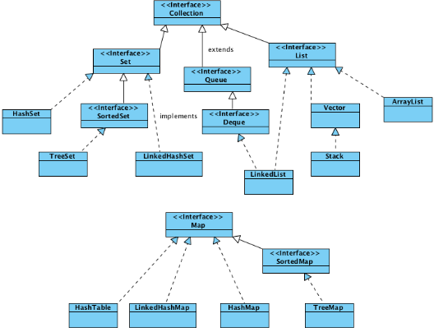
Java Collections API

Slide 4
Introduction
A collection — sometimes called a container — is simply an object that groups multiple elements into a single unit.
Collections are used to store, retrieve, manipulate, and communicate aggregate data.
They typically represent data items that form a natural group, e.g.
- poker hand (a collection of cards), a mail folder (a collection of letters), or a telephone directory (a mapping from names to phone numbers).

Slide 5
Collection Interface Methods
boolean add(Object o);
void clear();
boolean contains(Object o);
boolean equals(Object o);
boolean remove(Object o);
Iterator iterator();
Object[] toArray();
boolean addAll(Collection c);
boolean isEmpty();
boolean containsAll(Collection c);
int hashCode();
boolean removeAll(Collection c);
boolean retainAll(Collection c);
int size();
Object[] toArray(Object[] a);

Slide 6
List Interface
An interface that extends the Collections interface.
An ordered collection (also known as a sequence).
The user of this interface has precise control over where in the list each element is inserted.
The user can access elements by their integer index (position in the list), and search for elements in the list.
Allows duplicate elements.

Slide 7
List Implementation
There are two concrete implementations of the List interface
LinkedList
ArrayList
Which is best to use depends on specific needs.
Linked lists tend to be optimal for inserting/removing elements.
ArrayLists are good for traversing elements sequentially
Note that LinkedList and ArrayList both extend abstract partial implementations of the List interface.

Slide 8
ArrayList Class
Similar to Vector except that it’s unsynchronized
Can contain duplicate values, it also allows “null” value.
Objects in are added in order
Default capacity is defined as 10.
Java ArrayList Iterator and ListIterator implementation is fail-fast. If structure is modified after creating the iterator in any other way except the iterator add or remove methods, it will throw ConcurrentModificationException.
Provides random access to it’s elements because it works on index.
Supports Generics and it’s the recommended way to create an ArrayList.
ArrayList is much worse at inserting elements.

Slide 9
LinkedList Class
LinkedList class is a member of the Java Collections Framework.
Implementation of the List and Deque interfaces.
Internally, it is implemented using Doubly Linked List Data Structure.
It supports duplicate elements as well as null elements.
It stores and maintains its elements in Insertion order.
It is not synchronised that means it is not Thread safe.
We can create a synchronised LinkedList using Collections.synchronizedList() method.
In Java applications, we can use it as a List, stack or queue.
Does not implement RandomAccess interface.
We can use ListIterator to iterate LinkedList elements.

Slide 10
LinkedList Class
The LinkedList class offers a few additional methods for directly manipulating the ends of the list:
void addFirst(Object)
void addLast(Object);
Object getFirst();
Object getLast();
Object removeFirst();
Object removeLast();
These methods make it natural to implement other simpler data structures, like Stacks and Queues.

Slide 11
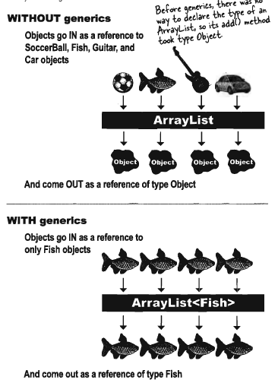
Generics - Java’s way of doing type safety

Slide 12
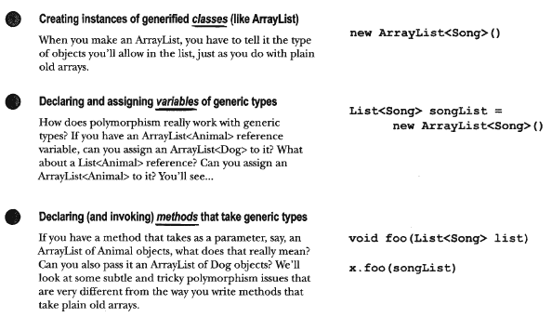
Generics - Java’s way of doing type safety
https://www.geeksforgeeks.org/generics-in-java/

Slide 13
Exercise
class Person {}
class Employee extends Person {}
Play with creating List of Employee and Person type.
Java Generics Problem: https://stackoverflow.com/a/13409697/1799527

Slide 14
Set Interface
Set also extends Collection, but it prohibits duplicate items (this is what defines a Set).
No new methods are introduced; specifically, none for index-based operations (elements of Sets are not ordered).
Concrete Set implementations contain methods that forbid adding two equal Objects.
More formally, sets contain no pair of elements e1 and e2 such that e1.equals(e2), and at most one null element
Java has two implementations: HashSet, TreeSet

Slide 15
HashSet Class
Implements Set Interface.
add elements with add(Object) method
contains(Object) is redefined to first look for duplicates.
if duplicate exists, Object is not added
What determines a duplicate?
careful here, must redefine both hashCode() and equals(Object)!
LinkedHashSet Class
LinkedHashSet class extend HashSet Class.
LinkedHashSet maintains insertion order of elements much like List interface .
https://javaconceptoftheday.com/hashset-vs-linkedhashset-vs-treeset-in-java/

Slide 16
Map Interface
Maps are similar to collections but are actually represented by an entirely different class hierarchy.
Maps store objects by key/value pairs:
map.add(“1234”, “Andrew”);
ie Object Andrew is stored by Object key 1234
Keys not be duplicated
Each key map to only one value

Slide 17
Map Interface methods
void clear()
boolean containsKey(Object)
boolean containsValue(Object)
Set entrySet()
boolean get(Object)
boolean isEmpty()
Set keySet()
Object put(Object, Object)
void putall(Map)
Object remove(Object)
int size()
Collection values()

Slide 18
Map implementation
HashMap
A hashtable implementation of a map good for quick searching where order doesn’t matter.
Must override hashCode and equals
LinkedHashMap
A Linkedhashtable implementation of a map good for quick searching where order matter.
Must override hashCode and equals.

Slide 19
Exercise
We have a list of unique names, which collection should we use so that we can efficiently check whether a given name exists in our list or not.

Slide 20
Iterator Interface
An iterator is a mechanism used to step through the elements of a collection one by one
Each element is “delivered ” exactly once
The Java API has a generic interface called Iterator<T> that specifies what methods are required of an iterator.
public boolean hasNext( );
returns true if there are more elements in the iteration.
public T next( );
returns the next element in the iteration.
public void remove( );
removes the last element returned by the iterator.

Slide 21
ListIterator - Special Iterator for List
It is available since Java 1.2.
It extends Iterator interface.
It is useful only for List implemented classes.
Unlike Iterator, It supports all four operations: CRUD
Unlike Iterator, It supports both Forward Direction and Backward Direction iterations.
It is a Bi-directional Iterator.
It has no current element; its cursor position always lies between the element that would be returned by a call to previous() and the element that would be returned by a call to next().

Slide 22
Object equality - hashcode() equals() contract
equals() in Object
override equals
hashcode()
Understand hashing
https://www.javabrahman.com/corejava/understanding-equals-and-hashcode-contract-when-using-collections-in-java/

Slide 23
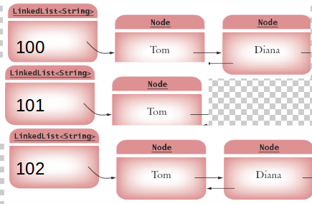
Hash Concept
HashCode method - To identify the bucket number .
Equals method - If multiple elements have the same hash code, they are stored in a Linked list. elements must also have an equals method for checking whether an element equals another

Slide 24
Comparable and Comparator Interface
Many java classes already implement comparable interface. Try String, Character, Integer, etc.
Your own classes will have to do this explicitly:
Comparable defines the method
public int compareTo(Object other);
Comparator defines the method
public int compare(Object a, Object b);

Slide 25
Exercise
Write a Athlete class with following attributes:
String name
String sport
String country
int world_rank
List<String> medals
Make it comparable on world_rank and write a comparator class for Athlete called AthleteComparator which compares based on medals.

Slide 26
Collections Class Methods
static void sort(List list1)
static void sort(List list1, Comparator comp)
static int binarySearch(List list1, Object obj1)
static void reverse(List list1)
static void shuffle(List list1)
static void swap(List list1, int index1, int index2)
static Object min(Collection col1)
static Object max(Collection col1)
static int indexOfSubList(List source, List target)
static Collection unmodifiableCollection(Collection col1)
static Collection synchronizedCollection(Collection col1)
static int frequency(Collection col1, Object obj1)

Slide 27
Date
The calendar that we use today, called Gregorian calendar, came into effect in October 15, 1582 in some countries and later in other countries. It replaces the Julian calendar. 10 days were removed from the calendar, i.e., October 4, 1582 (Julian) was followed by October 15, 1582 (Gregorian). The only difference between the Gregorian and the Julian calendar is the "leap-year rule". In Julian calendar, every four years is a leap year. In Gregorian calendar, a leap year is a year that is divisible by 4 but not divisible by 100, or it is divisible by 400.

Slide 28
Date (contd.)
java.util.* is the package location for date and time classes
Date class represents a point in time say 10th August, 2018 10:02:10 AM
Calendar class is an abstract class that provides methods for converting between a specific instant in time and a set of calendar fields.
Current date and time (in milliseconds) after 1st January, 1970 00:00:00 UTC can be get using System.currentTimeMillis( )

Slide 29
Date (contd.)
Issues with the Old Date/Time APIs in comparison with new APIs (Java 8)
Thread Safety – The Date and Calendar classes are not thread safe, leaving developers to deal with the headache of hard to debug concurrency issues and to write additional code to handle thread safety. On the contrary the new Date and Time APIs introduced in Java 8 are immutable and thread safe, thus taking that concurrency headache away from developers.
APIs Design and Ease of Understanding – The Date and Calendar APIs are poorly designed with inadequate methods to perform day-to-day operations. The new Date/Time APIs is ISO centric and follows consistent domain models for date, time, duration and periods. There are a wide variety of utility methods that support the commonest operations.
ZonedDate and Time – Developers had to write additional logic to handle timezone logic with the old APIs, whereas with the new APIs, handling of timezone can be done with Local and ZonedDate/Time APIs.

Slide 30
DateFormatter
The java.text.SimpleDateFormat class provides methods to format and parse date and time in java. The SimpleDateFormat is a concrete class for formatting and parsing date which inherits java.text.DateFormat class.

Slide 31
DateFormatter (contd.)
G Era designator (before christ, after christ)
y Year (e.g. 12 or 2012). Use either yy or yyyy.
M Month in year. Number of M's determine length of format (e.g. MM, MMM or MMMMM)
d Day in month. Number of d's determine length of format (e.g. d or dd)
h Hour of day, 1-12 (AM / PM) (normally hh)
H Hour of day, 0-23 (normally HH)
m Minute in hour, 0-59 (normally mm)
s Second in minute, 0-59 (normally ss)
S Millisecond in second, 0-999 (normally SSS)
E Day in week (e.g Monday, Tuesday etc.)
D Day in year (1-366)
F Day of week in month (e.g. 1st Thursday of December)
w Week in year (1-53)
W Week in month (0-5)
a AM / PM marker
k Hour in day (1-24, unlike HH's 0-23)
K Hour in day, AM / PM (0-11)
z Time Zone
' Escape for text delimiter
' Single quote

Slide 32
Questions ?

Slide 33
https://www.journaldev.com/1260/collections-in-java-tutorial

